Slide 1

Grid
01
02
Layout and Position
03

Slide 2
Content
01
Position
02
Grid Container
03
Grid Items

Slide 3
01
Position
What is Positioning?

Slide 4
What is positioning?
Specifies the type of positioning method used for an element:
static | relative | fixed | absolute | sticky
Elements are positioned using top, bottom, left, and right.
These properties will NOT work if the position property is not set. Work differently depending on the position value.
https://developer.mozilla.org/en-US/docs/Web/CSS/position

Slide 5
Position
position: static;
Default state of every element — it just means "put the element into its normal position in the document layout flow — nothing special to see here."
.element {
position: static;
}

Slide 6
Position
position: relative;
Like static positioning, except that once the element has taken its place in the layout flow, you can modify its final position, including making it overlap other elements.
.element {
position: relative;
}

Slide 7
Position
position: absolute;
Position the element based on a coordinate system.
Use left, top, bottom, right to place the element exactly where we want.
.element {
position: absolute;
}

Slide 8
Position
position: fixed;
Removed from the normal document flow.
Positioned relative to its initial containing block. Its final position is determined by the values of top, right, bottom, and left.
.element {
position: fixed;
}

Slide 9
Position
position: sticky;
Positioned according to the normal flow of the document, and then offset relative to its nearest scrolling ancestor and containing block, based on the values of top, right, bottom, and left.
.element {
position: sticky;
}

Slide 10
Position
position: sticky;
Sticky element "sticks" to its nearest ancestor that has a "scrolling mechanism" (created when overflow is hidden, scroll, auto, or overlay), even if that ancestor isn't the nearest scrolling ancestor.
.element {
position: sticky;
}

Slide 11
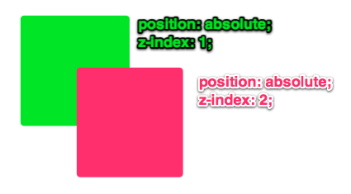
Position
z-index
Sets the z-order of a positioned element. Overlapping elements with a larger z-index cover those with a smaller one.
https://interactive-examples.mdn.mozilla.net/pages/css/z-index.html
.element {
z-index: [number];
}

Slide 12
02
Grid
Two-dimensional grid-based layout

Slide 13
display: grid;
Defines the element as a grid container and establishes a new grid formatting context for its contents.
.container {
display: grid;
}

Slide 14
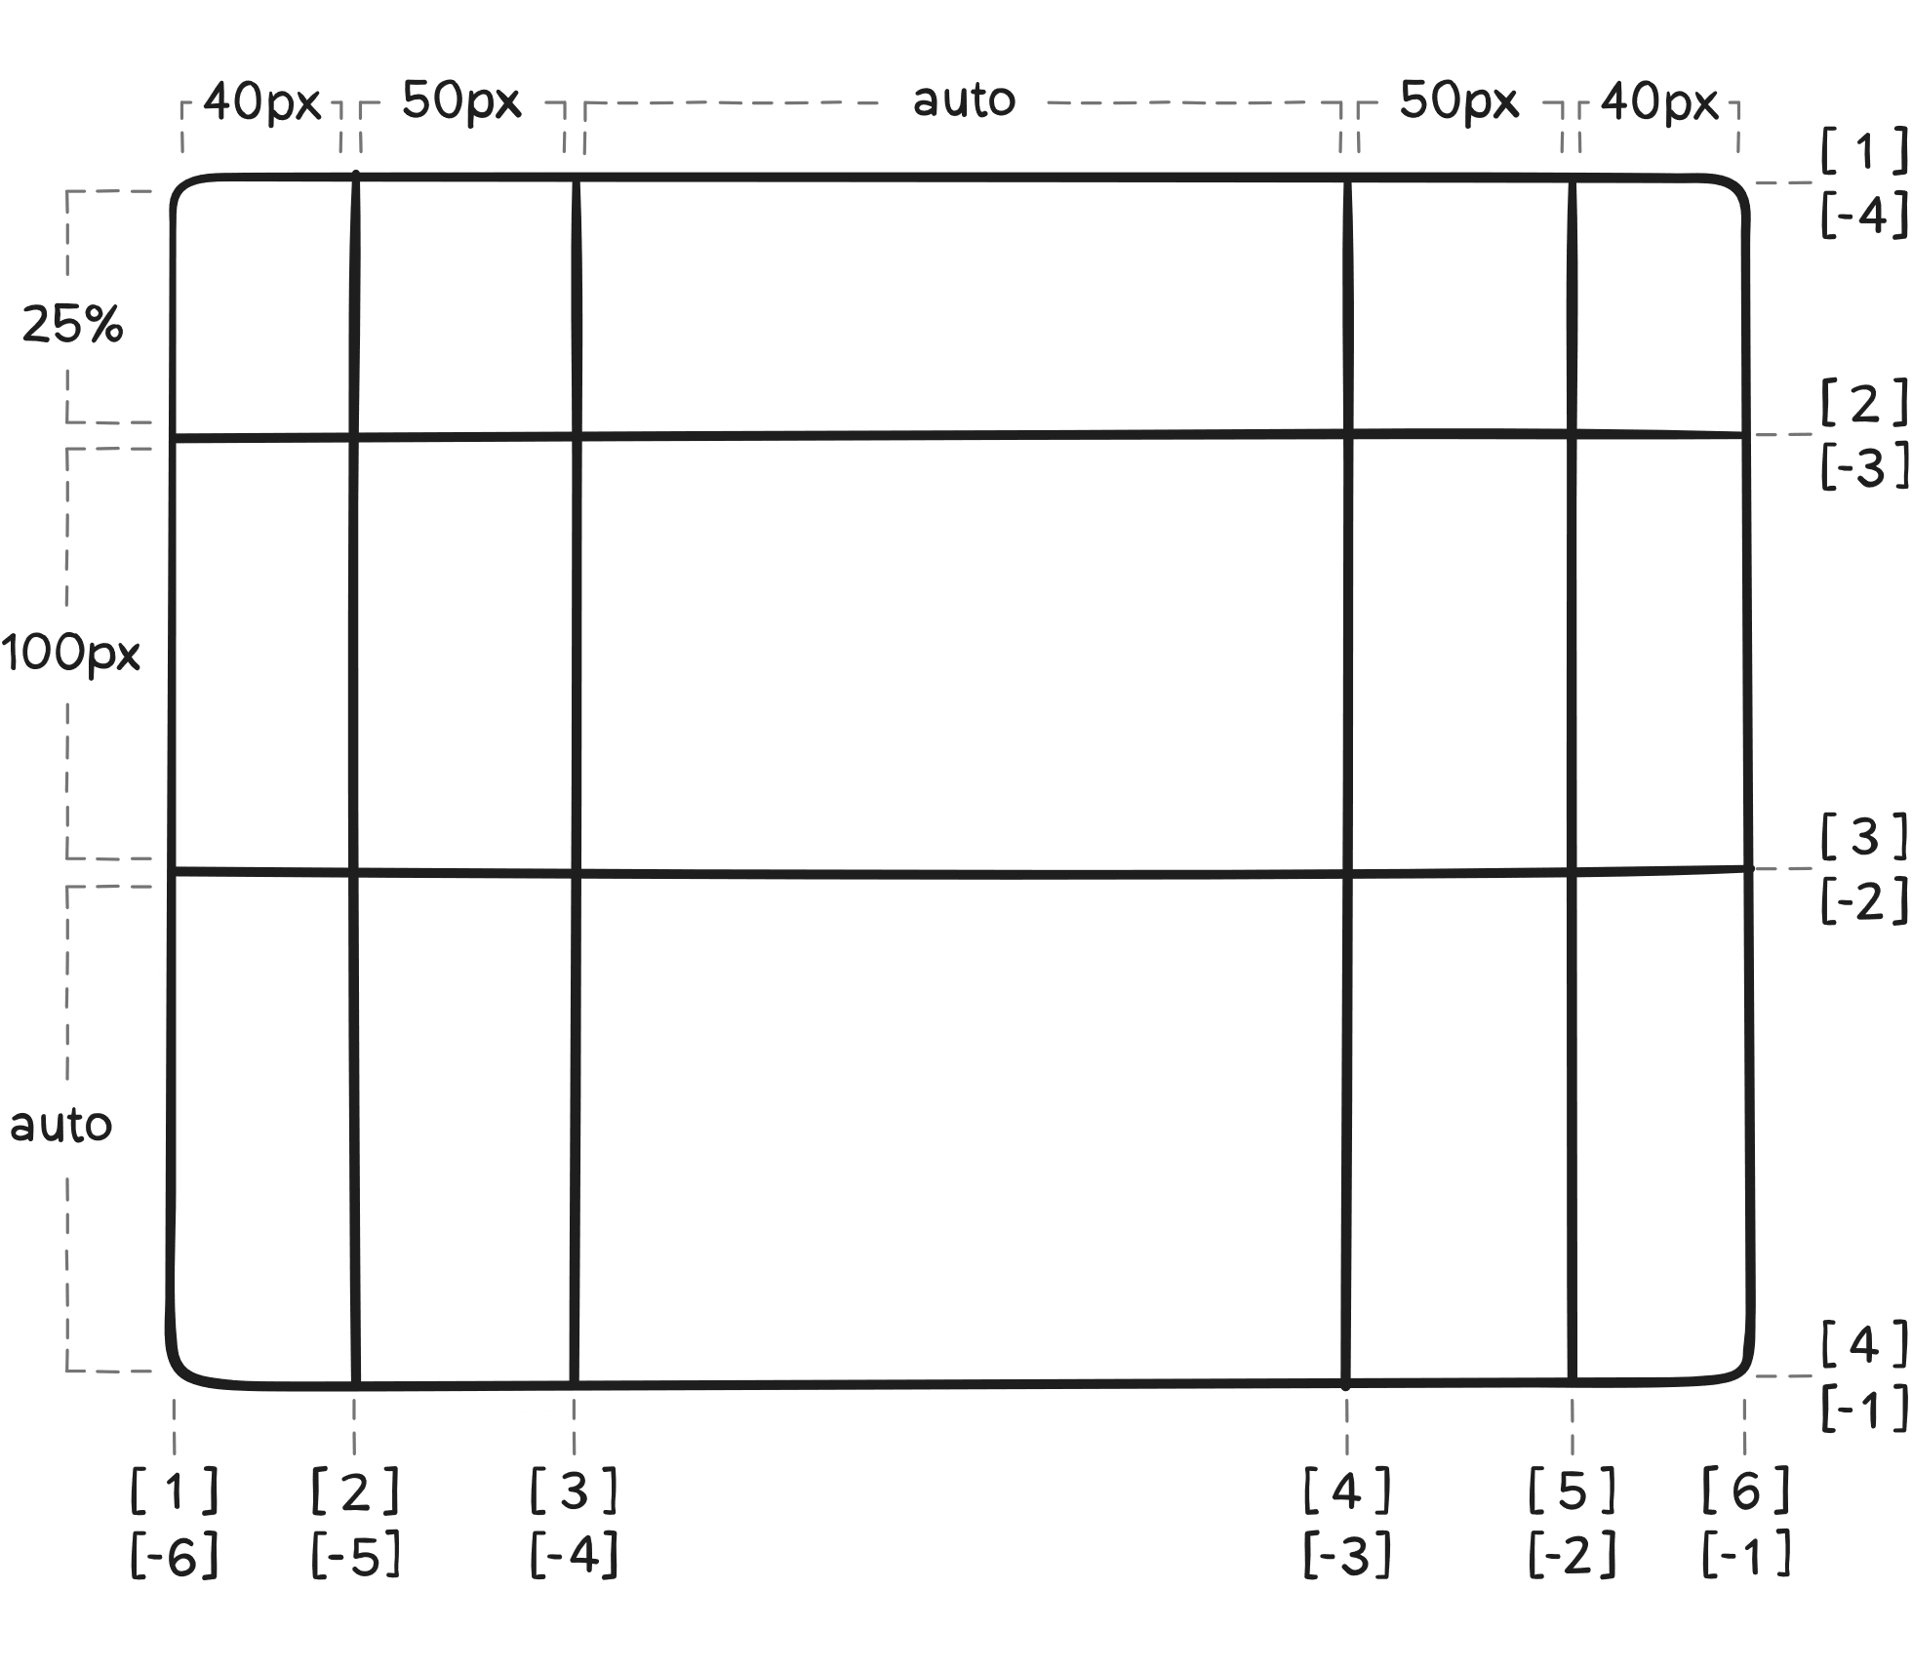
grid-template
Defines the columns and rows of the grid with a space-separated list of values.
.container {
grid-template-columns: ... ...;
grid-template-rows: ... ...;
}

Slide 15
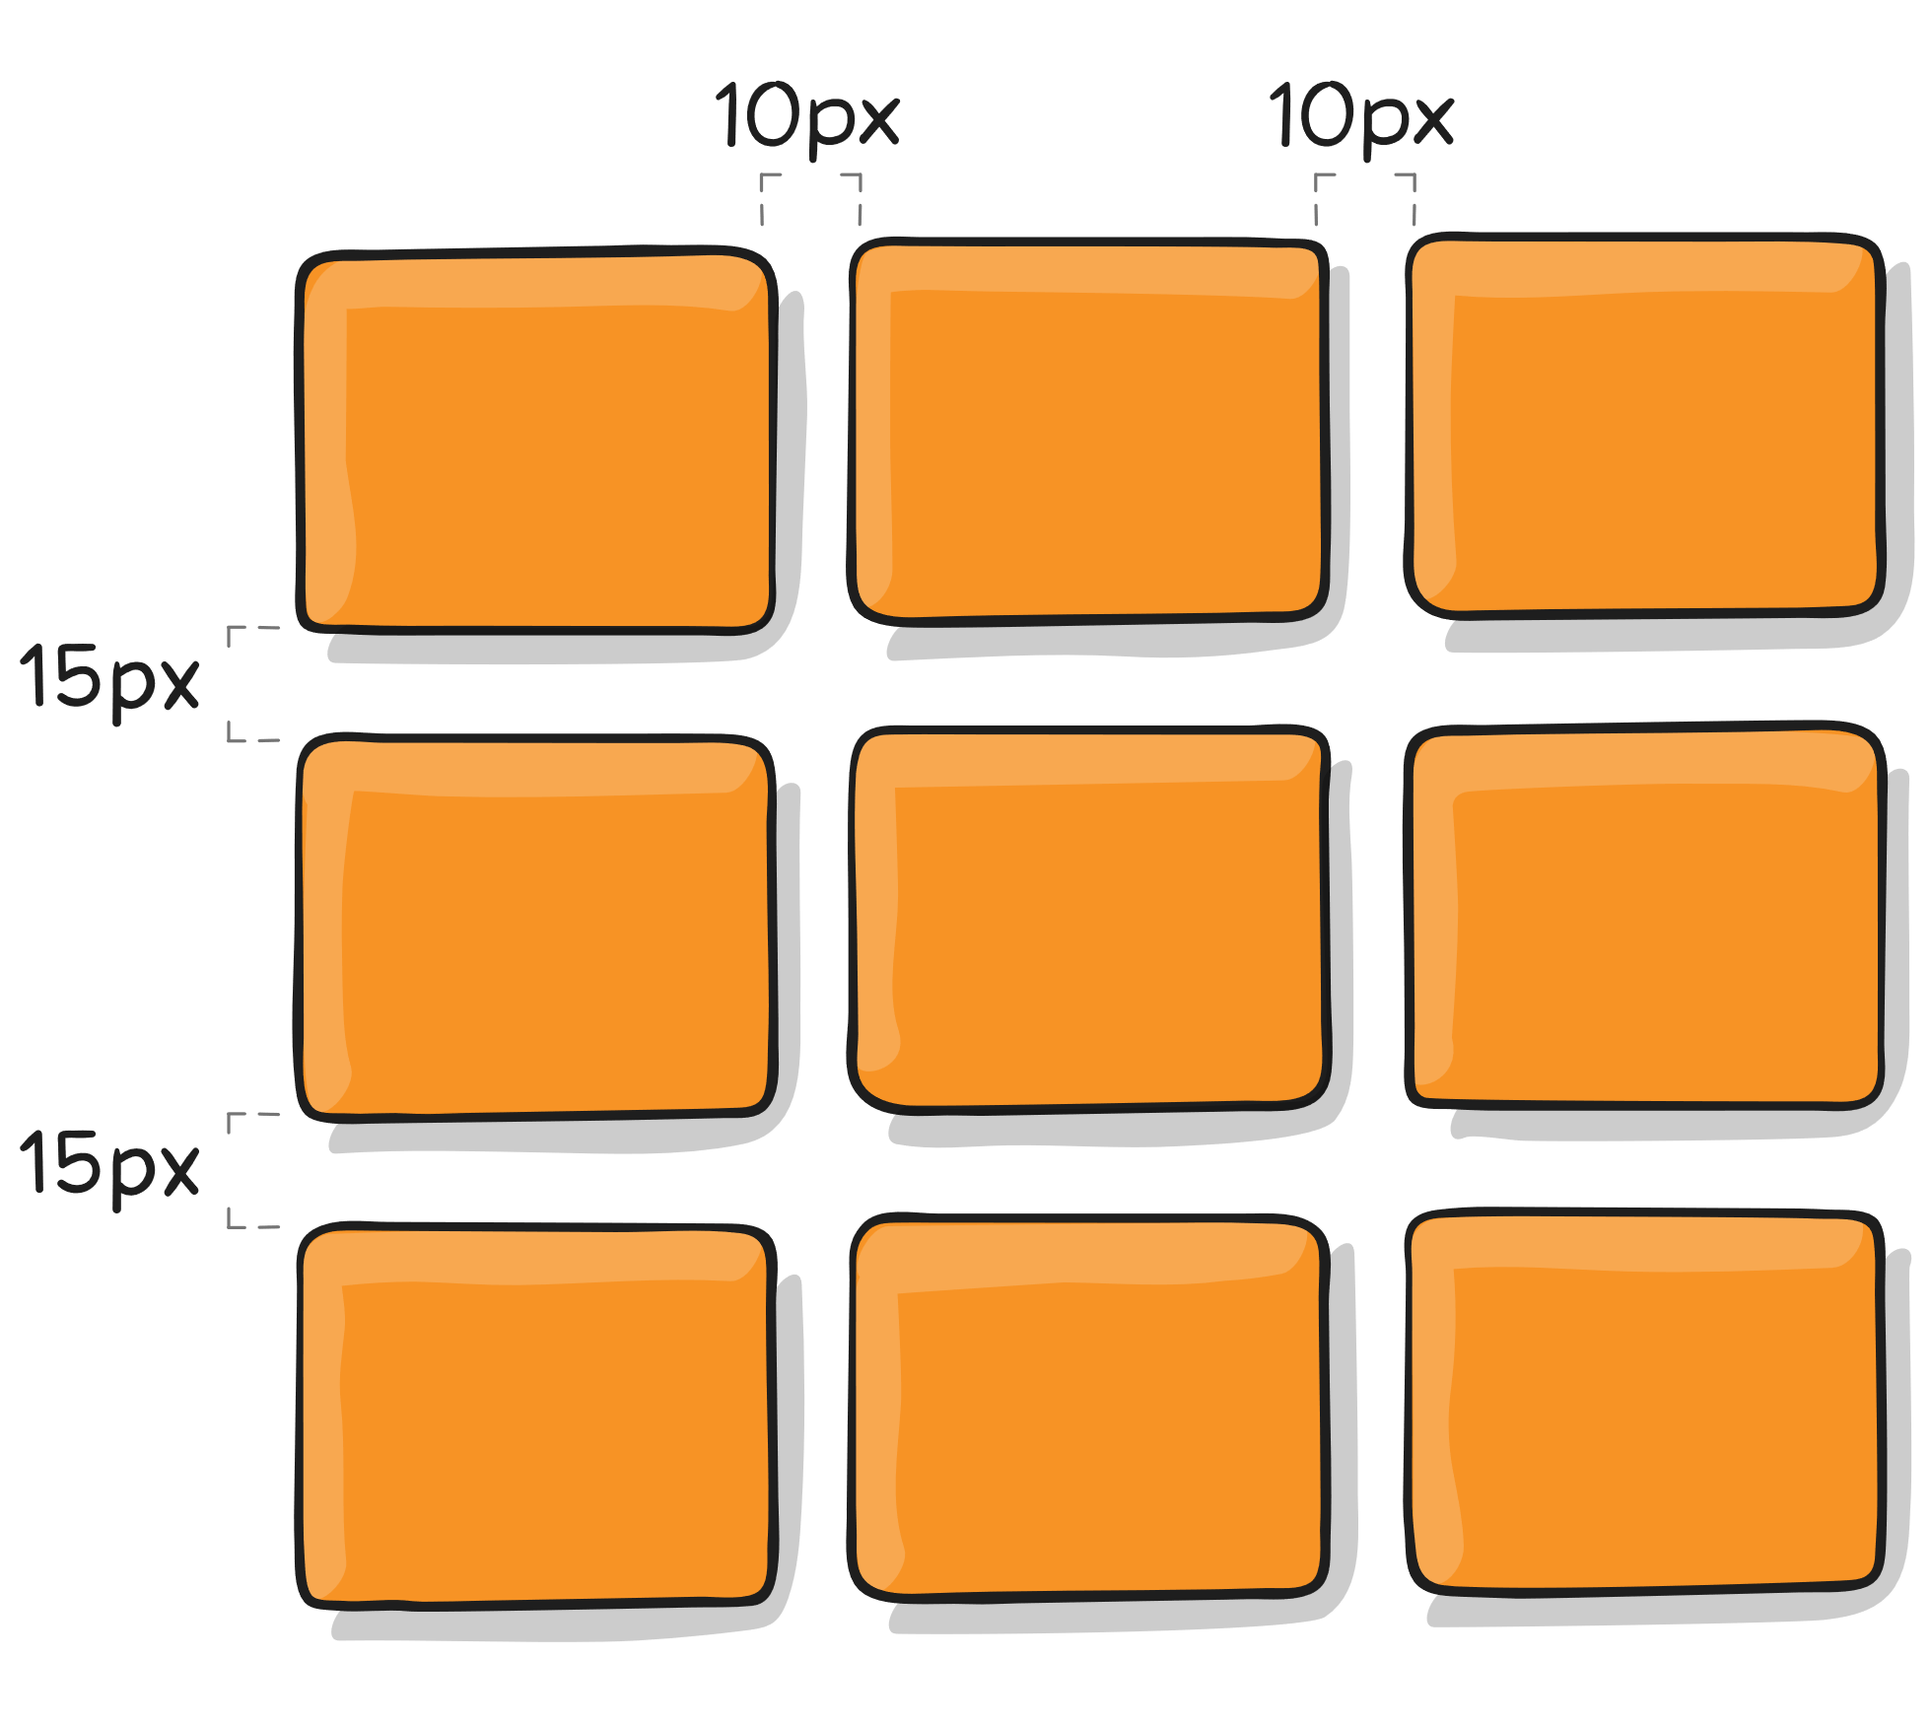
gap
Specifies the size of the grid lines. You can think of it like setting the width of the gutters between the columns/rows.
.container {
column-gap: 10px;
row-gap: 15px;
/* gap: 10px 15px; */
}

Slide 16
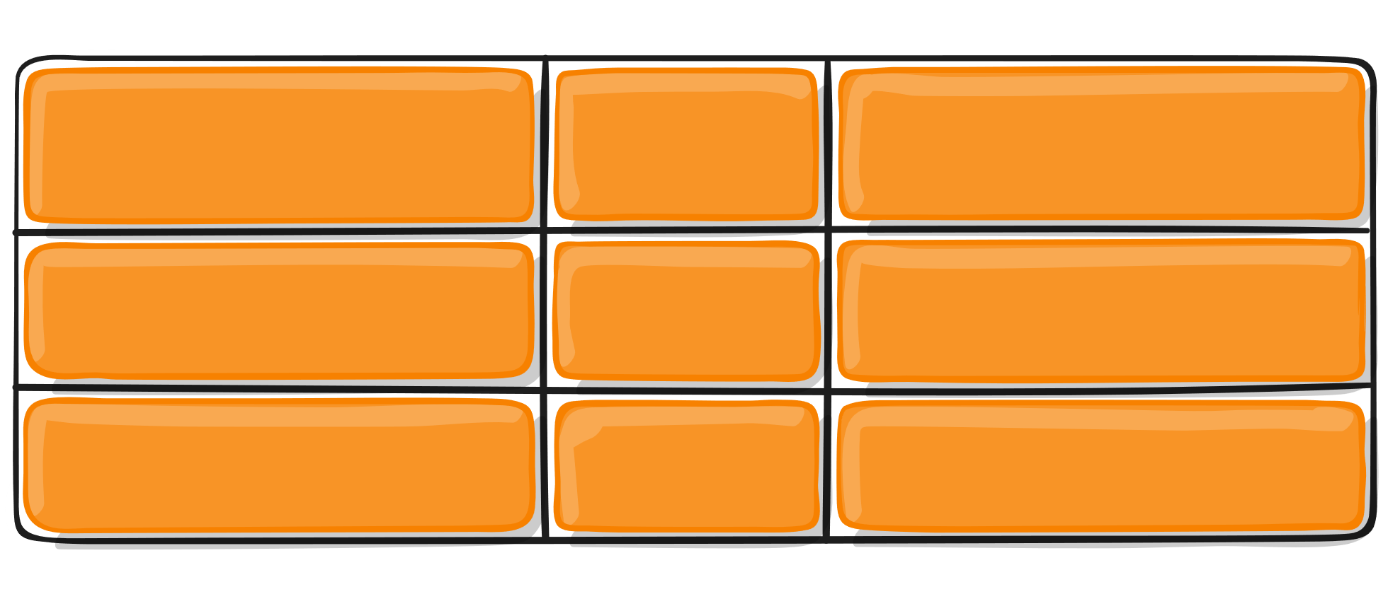
justify-items
start | end | center | stretch
Aligns grid items along the inline (row) axis (as opposed to align-items which aligns along the block (column) axis).
.container {
justify-items: stretch;
}

Slide 17
align-items
start | end | center | stretch | baseline
Aligns grid items along the block (column) axis (as opposed to justify-items which aligns along the inline (row) axis).
https://css-tricks.com/snippets/css/complete-guide-grid/
.container {
align-items: stretch;
}

Slide 18
03
Items
Grid Items Properties

Slide 19
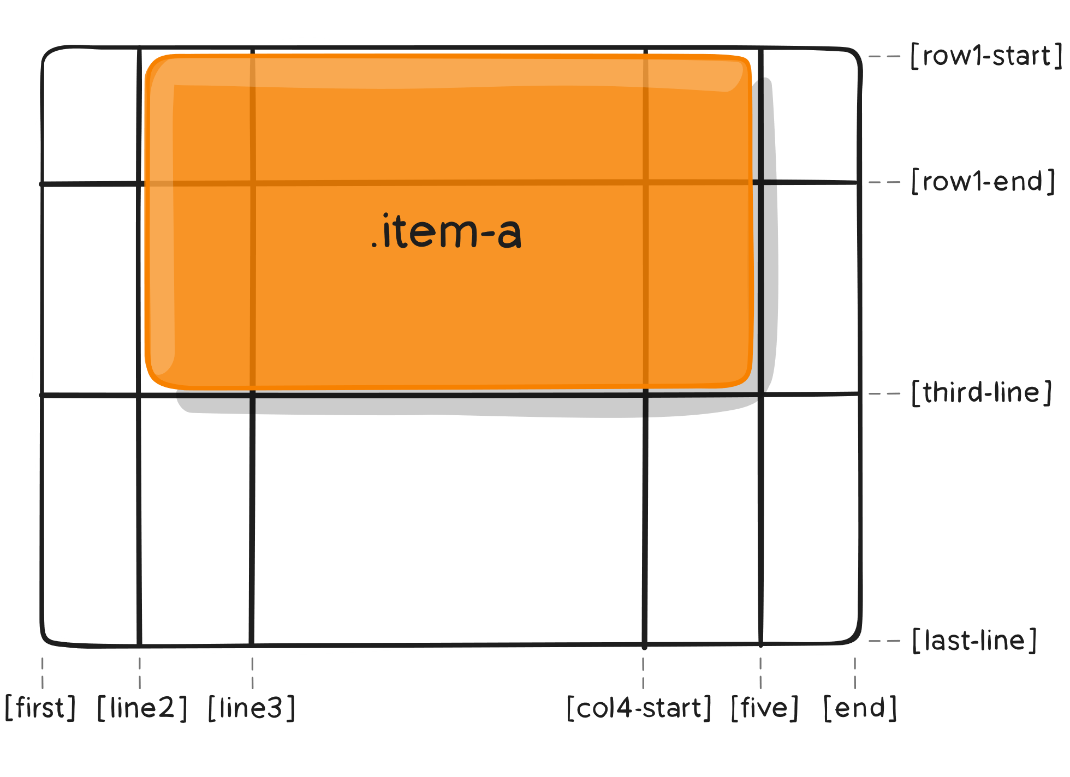
column row start end
grid-column-start grid-column-end
grid-row-start grid-row-end
.item-a {
grid-column-start: 2;
grid-column-end: five;
grid-row-start: row1-start;
grid-row-end: 3;
}

Slide 20
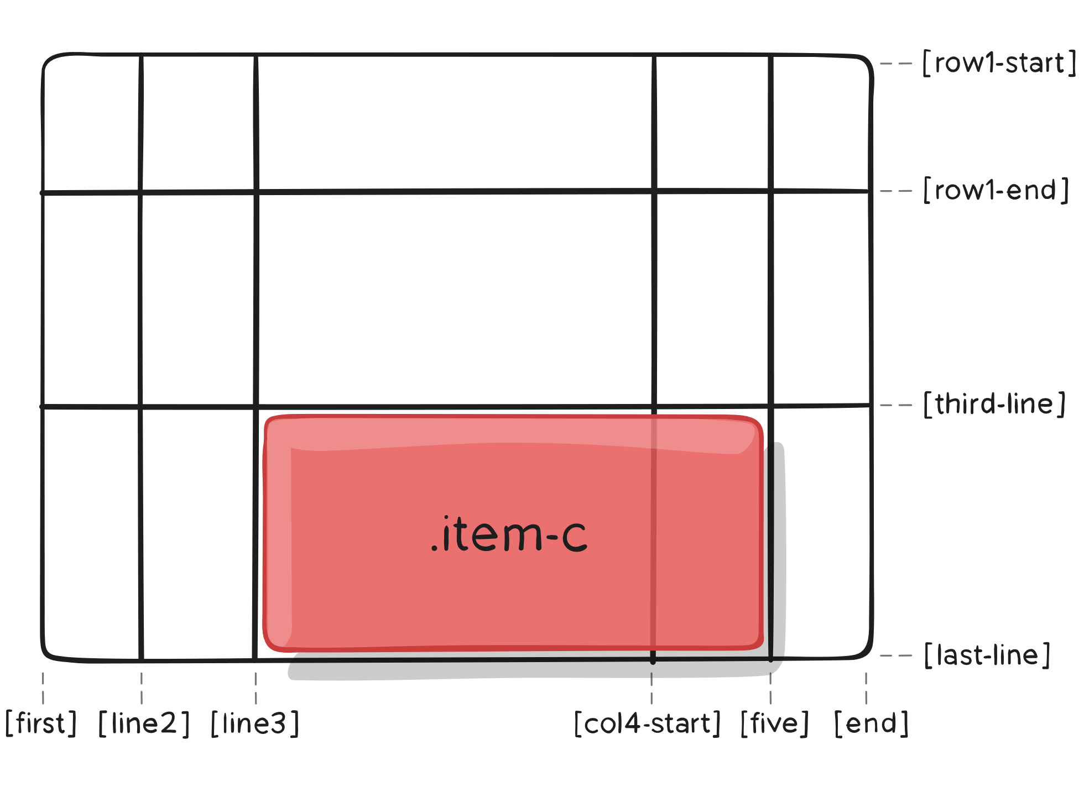
grid-column | row
Shorthand for grid-column-start + grid-column-end and grid-row-start + grid-row-end
.item-c {
grid-column: 3 / span 2;
grid-row: third-line / 4;
}

Slide 21
fr units
Fr (fractional units) mean “portion of the remaining space”.
Means: 25% and 75% Practice here:
https://cssgridgarden.com/
.item-c {
grid-template-columns: 1fr 3fr;
}

Slide 22
Exercises
https://cssgridgarden.com/
https://css-tricks.com/snippets/css/complete-guide-grid
https://www.joshwcomeau.com/css/interactive-guide-to-grid/
https://codingfantasy.com/games/css-grid-attack

